Slide 1

San Francisco Salary Exploration and Analysis
Exploring and Visualizing the Gender Pay Gap

Slide 2
The Data
The data for this project comes from a sqlite file that contained ~150,000 entries that included the name, occupation, base pay, overtime pay, and total pay for San Francisco government employees during the years 2011-2014.
https://www.kaggle.com/kaggle/sf-salaries/discussion/18264 Attached here is the link to the datasource.
Below is an example of how the database is formatted. To view the jupyter notebook clink this link: https://github.com/Romainedavid92/project_2_group_1/blob/master/SF_Employee_Salary_Data.ipynb
 | Id | EmployeeName | JobTitle | BasePay | OvertimePay | OtherPay | Benefits | TotalPay | TotalPayBenefits | Year | Notes | Agency | Status
148281 | 148623 | Jacqueline Hubbard | Senior Clerk | 0 | 0.0 | 13.77 | 0 | 13.77 | 13.77 | 2014 |  | San Francisco | PT
148282 | 148624 | Deborah B Honig | Attorney (Civil/Criminal) | 0 | 0.0 | 13.35 | 0.13 | 13.35 | 13.48 | 2014 |  | San Francisco | PT
148283 | 148625 | Lorraine Rosenthal | Senior Clerk | 0 | 0.0 | 12.89 | 0 | 12.89 | 12.89 | 2014 |  | San Francisco | PT
148284 | 148626 | Renato C Gurion | Registered Nurse | 0 | 0.0 | 6.00 | 1.24 | 6.00 | 7.24 | 2014 |  | San Francisco | PT
148285 | 148654 | Joe Lopez | Counselor, Log Cabin Ranch | 0 | 0.0 | -618.13 | 0 | -618.13 | -618.13 | 2014 |  | San Francisco | PT

Slide 3
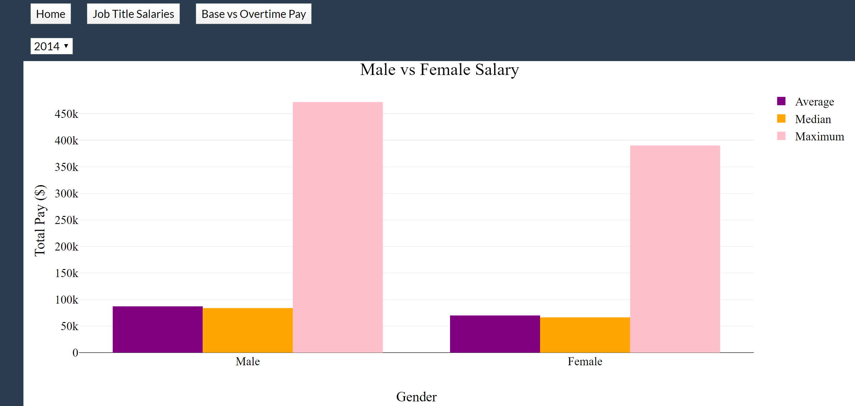
Average, Median, and Max Total Pay Male vs Female
Clip of Bar graph comparing various aspects of male and female salary differences.

Slide 4
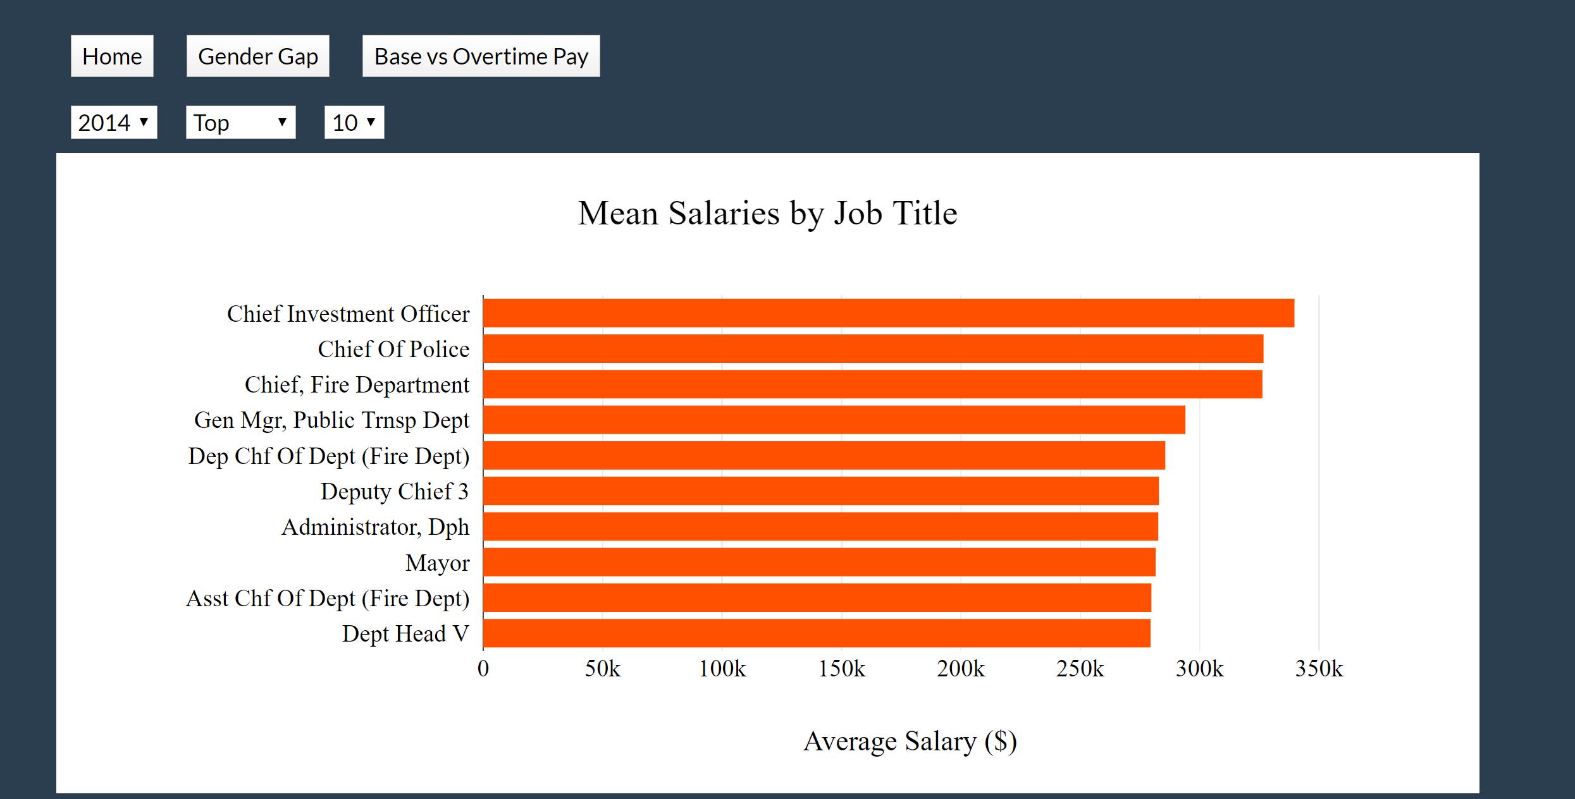
Top and Bottom Salaries by Job Title
Horizontal Bar chart that shows the top and bottom salaries by Job Title.

Slide 5
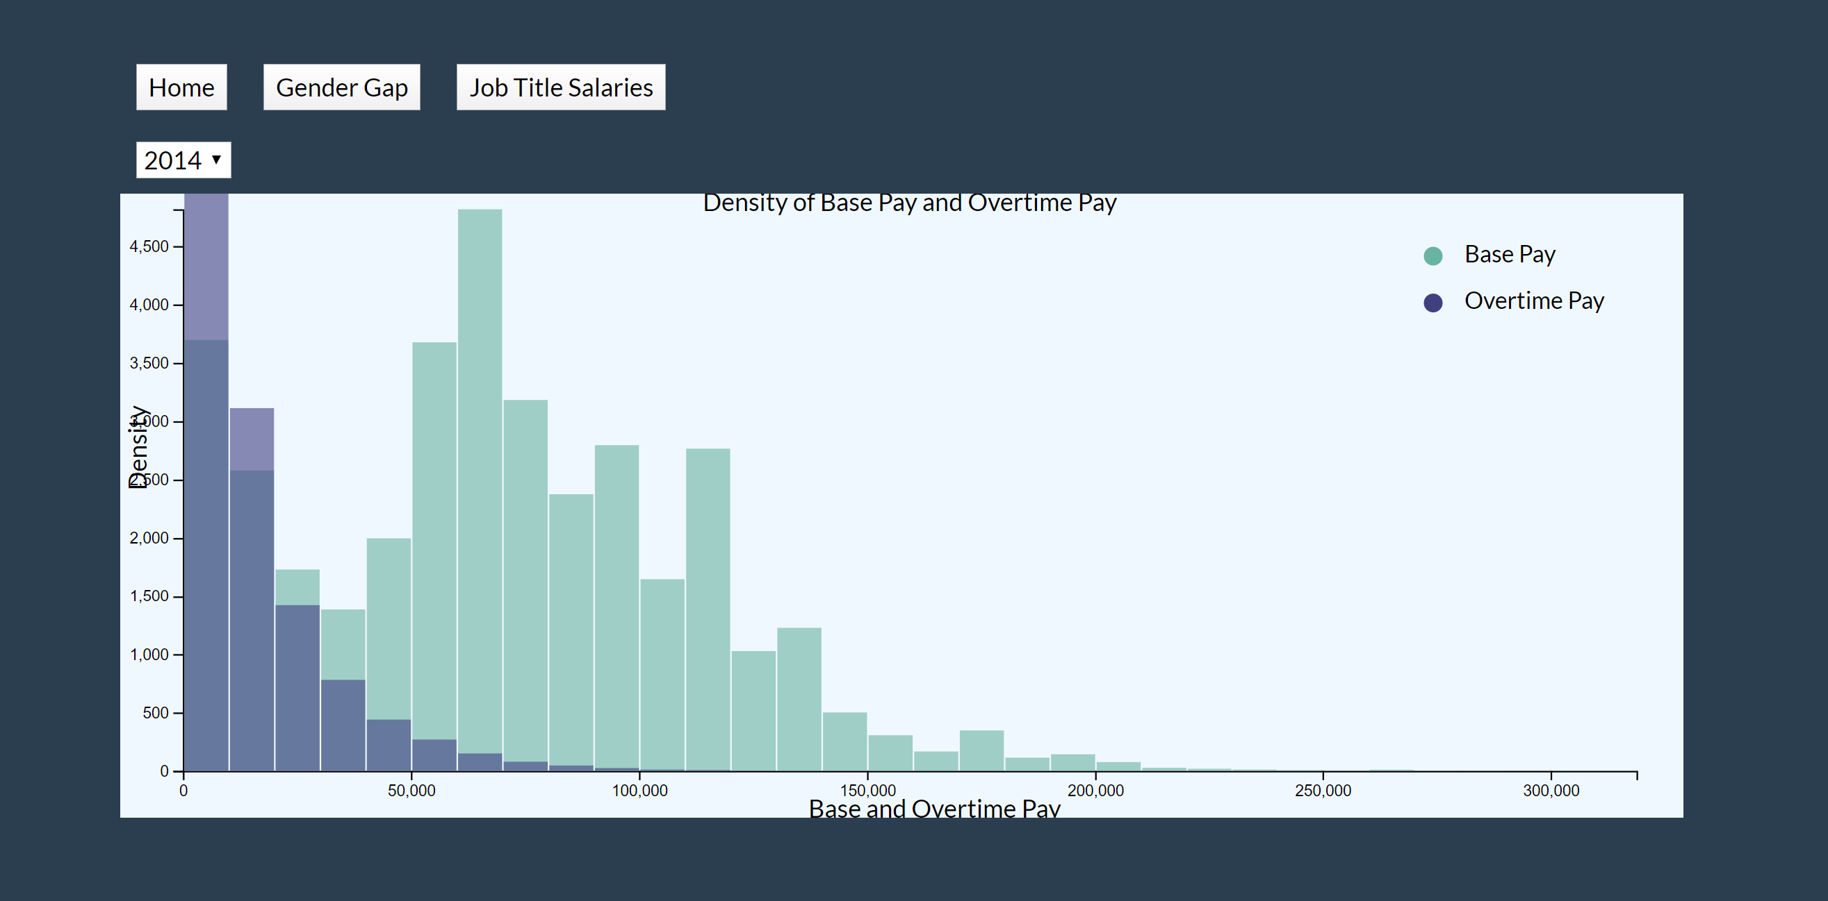
Salary Distribution Base Pay and Overtime Pay
Histogram showing salary distribution when comparing base pay and overtime pay.

Slide 6
Conclusions
Men get paid more than women when observing the average, median, and max salaries for 2011 to 2014.
Overtime Pay is not a significant factor in this comparison.
Public Police and Firefighters are paid very well.

Slide 7
Future Work
All graphs need to compare the gender differences.
01
All graphs need to be interactive and contain hovert
02
Create a more beautiful webpage. i.e add a navigation bar instead of buttons
03

